Slide 1
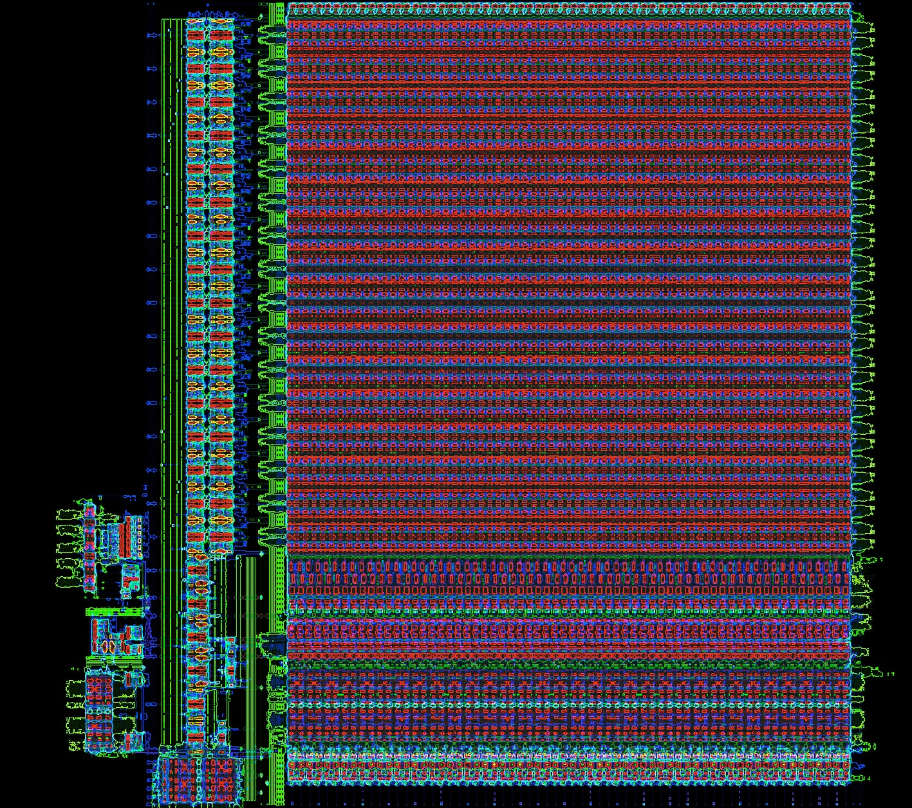
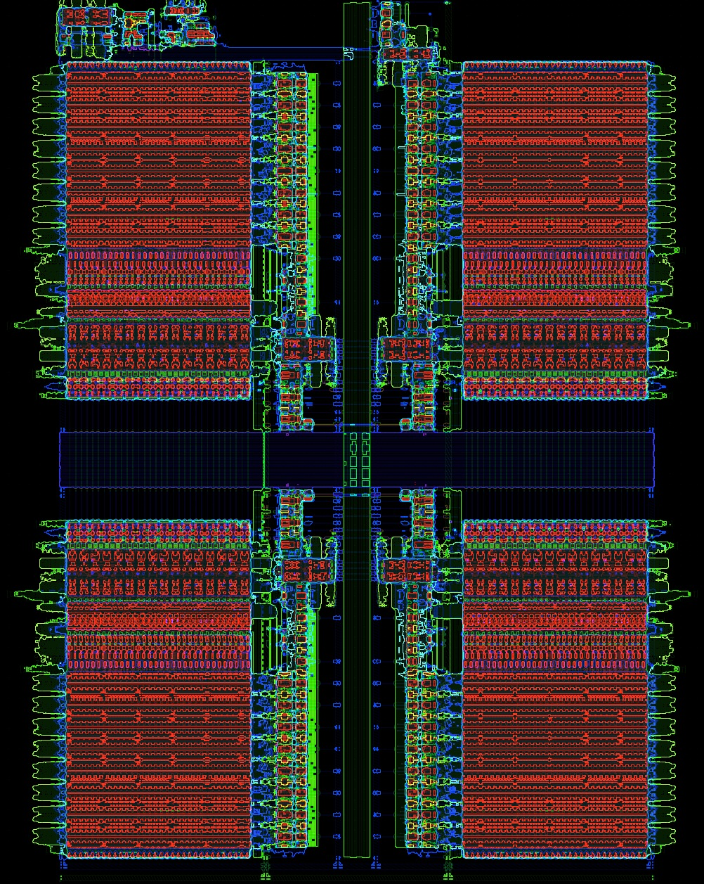
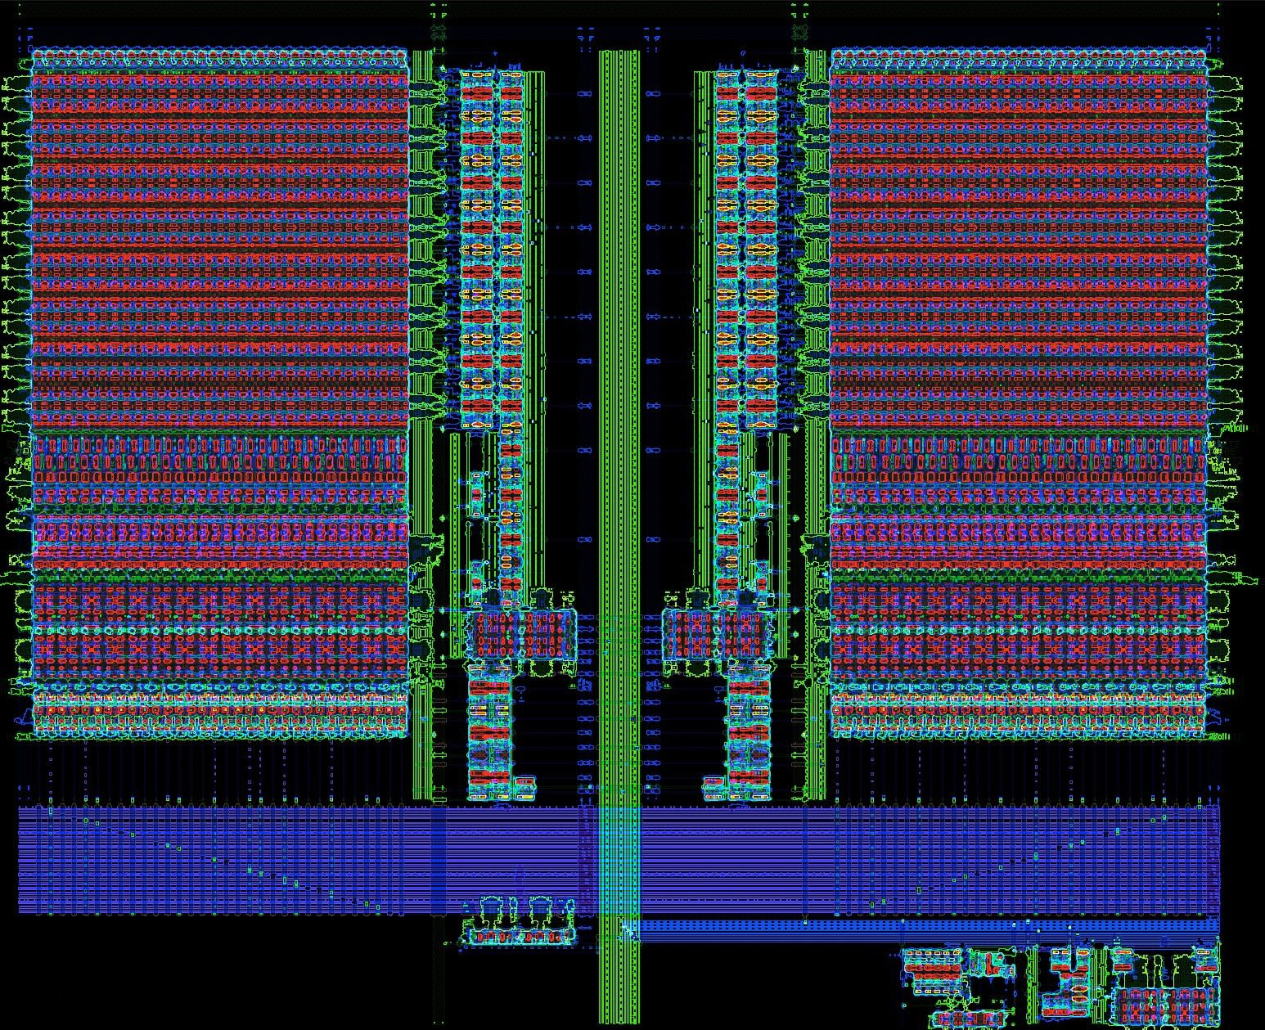
2 Kb (1 bank x 32 words x 64 bits)
4 Kb (4 banks x 32 words x 32 bits)
1 Kb (2 banks x 16 words x 32 bits)

